Slide 1
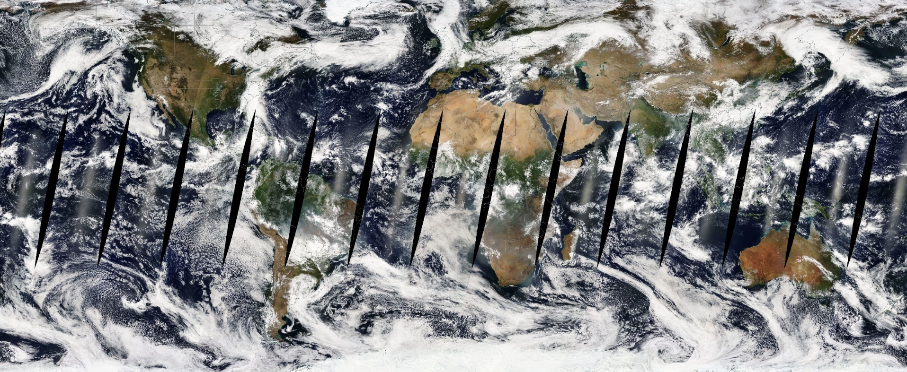
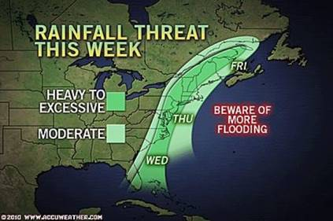
The Understanding of Pollutant Transport in the Atmosphere: Lagrangian Coherent Structures
Peter Nolan, Hosein Foroutan, Shane Ross
Department of Biomedical Engineering and Mechanics, Virginia Tech, Blacksburg VA, USA
contact email: foroutan@vt.edu
Introduction
WRF-CMAQ Simulations: Southeast U.S.
MPAS-A Simulations: Global
Eulerian chemical transport models (e.g., CMAQ) are powerful tools to simulate the transport and fate of air pollutants in various scales from local to global. Informed by meteorological drivers (e.g., WRF), these models calculate the advection of gases and aerosols in the atmosphere and provide information about how pollutants are transported from one location to another.
Identifying atmospheric transport pathways and barriers is important to understand pollutants effects on weather, climate, and human health. The atmospheric wind field is variable in space and time and contains complex patterns due to turbulence mixing. In such a highly unsteady flow field, streamlines (Eulerian entities showing the local direction of the velocity at any given instant) do not provide useful information regarding the transport over a finite time. Therefore, particle trajectories are often used to study how pollutants move in the atmosphere. Nevertheless, individual trajectories are sensitive to their initial conditions, cannot fully resolve the complexity of the flow, and often result in a chaotic and tangled field difficult to analyze. Therefore, a more systematic and robust approach is needed.
Simulations are performed using Model for Prediction Across Scales-Atmosphere (MPAS-A), a global fully compressible non-hydrostatic model with centroidal Voronoi grids (nominally hexagonal).
MPAS-A v5.1
120-km and 60-km uniform horizontal mesh
41 vertical layers expanding up to 22 km
“Mesoscale_reference” physics suite, including YSU planetary boundary layer, RRTMG SW and LW radiation, new Tiedtke convection, WSM6 microphysics, and Noah land surface models.
24-hr simulations started at September 28, 2010, 12:00:00 UTC
Lagrangian Transport Structure
Lagrangian Transport Structrues (LTS), also referred to as Lagrangian Coherent Structures (LCS), form the template of fluid particle motion in a flow field. LTS
can be characterized by special material surfaces that organize the particle motion into ordered patterns. These key material surfaces form the core of fluid deformation patterns, such as saddle points, tangles, filaments, and pathways. LTS can be diagnosed using f
LTS is emerging as an important tool for evaluating fluid transport in engineering, medicine, and environmental and geophysical settings. Due to computational speed and data storage limitations, LTS is currently used as a post-processing tool.
Conclusions and Ongoing Research
Expand the chemistry module to include aerosols.
Further develop the I/O system and read in emissions data.
Conduct long-term and detailed evaluations against observations.
Develop model science and algorithms expandable to global scale, e.g.,
Continue advances in organic aerosols and new particle formation.
Develop integrated cloud model with convective transport, microphysics, aqueous chemistry, and aerosol-cloud interactions.
Develop emission process modeling for global coverage – (dust, biogenic, bidirectional flux, fires).

